Slide 1

Digital Rewards - Contact Centre Servicing
Technical – Digital rewards identification flow
System Linking diagram – proposed to-be
As-Is Systems diagram
Contact Centre HL reasons for contact & corresponding actions (As-Is)
Customer Journeys

Slide 2
Technical Digital rewards identification solution
Customer Flow
1
2
Customer signs up to Digital Rewards
Customer (MCH) contacts Contact Centre Agent
Customer Requests update on vouchers, agent needs to validate whether digitally enabled rewards customer
Agent has access to info, can support customer request
(Read only access Bank Contact Centre side(TBC))
3
Customer wants to Opt out of Digital Rewards
Selects button to “opt out of digital rewards” on Sparks App/Browser
Backend Flow - Bank
Backend Flow - PLC
My Workspace (MWS) screen displaying Linking status
Exceptions route to Opt Out via contact centre & PLC if “Read Only” access only
New API to call M&S Retail APIS
B2B API pattern (tbc)
Azure: Bank ID Linking Service
Returns customer data*
1
= Customer Journey No
Data passed across:
Digital Rewards Y/N
Customer history:
When they opted in (timestamp)
When they Opted out (timestamp) (having already opted them in) + back and forth
Sparks Customer Card No ( or at least last 4 digits)
Notes:
Read-write access to linking service? Or just read-only? (Write can opt out bank end (via contact centre), read only can only opt out (via sparks app)
Opt out process?
Dates/Timestamps?
Any other data required? :
Digital Rewards Y/N
When they opted in (timestamp)
When they Opted out (timestamp) (having already opted them in)
Customer history
Sparks Account No needed? (i.e – if customer has opted IN, but links to wrong sparks account so not receiving vouchers)
.COM email address? – data/security complexity
+Audit trail if needed
Escalation route – If contact agent cannot answer the Q e.g – technical issues, service desk? What if Issues with App etc?
Replacement Vouchers;
Rewards ( money-off) Can re-issue monetary > next QRM or send a swift with the info on(voucher no, expiry date & value, customer can use instore or online) ???
Bonus Offers - cant replace > good will points adjustment

Slide 3
E2E technical HL process
Customer Flow
Customer accesses Sparks App/Browser & completes verification
Open Banking: Verification & Customer enters Bank details
Confirmation of Linking Success (real-time)
Digital Rewards available in real-time in Sparks App/Browser
Customer Calls up Contact Centre with Query / Issue
Contact Centre can view my workspace screens and required data
Backend Flow - Plc
Account Linking Solution
Digital Identification Flag Solution
Digital ID request created, Linking Cloud Service – links digital ID to bank account
Updated in LPA
Data passed across:
Digital Rewards Y/N
Customer history:
When they opted in (timestamp)
When they Opted out (timestamp) (having already opted them in) + back and forth
Sparks Customer Card No ( or at least last 4 digits)
Azure: Bank ID Linking Service
Returns customer data*
B2B API pattern (tbc)
Backend Flow - Bank
Open Banking (rails)
Authenticates & Links accounts
Account number / CIN shared across to Sparks
New API to call M&S Retail APIS
My Workspace (MWS) screen displaying Linking status

Slide 4
SYSTEM LINKING INFO
M&S Retail Authenticated Session
M&S Retail Systems
OB Certs
Azure Linking Service
Open Banking Portal
API: Exposes linked data
B2B based security policy (tbc)
Returns Card Account Number
M&S Bank Systems
OBSS Portal:
Validates TSP
Provides consent token
Generates e2e trust token
AD group based entitlement verification
DSP/ Forgerock
My Workspace: Digital Linking page
API
Provides customer account data
API
Retrieve Rewards Data
CDU
OHC
Notes:
Sparks Hub Is M&S Retail Auth session (dark green)
Start linking journey
Call OB rails using O-auth
Token returned initializes linking in Azure Linking service
This is the best solution
Service:
API surfacing what current linking state is
MSB are not holding the flag – only need to be aware of it – flag held msb
Edit capability assumed needed
Budget card
Have joint account
Club Rewards –
What BAU file do we
HMW identify that a customer is a club rewards customer (ASAP – where is this currently maintained)
Rob V smith
Anabel (Chris cover)
OB CERT
HMW as MSR become a certified TPP for OB
Customer Service
We are continuing to service on MSB side

Slide 5
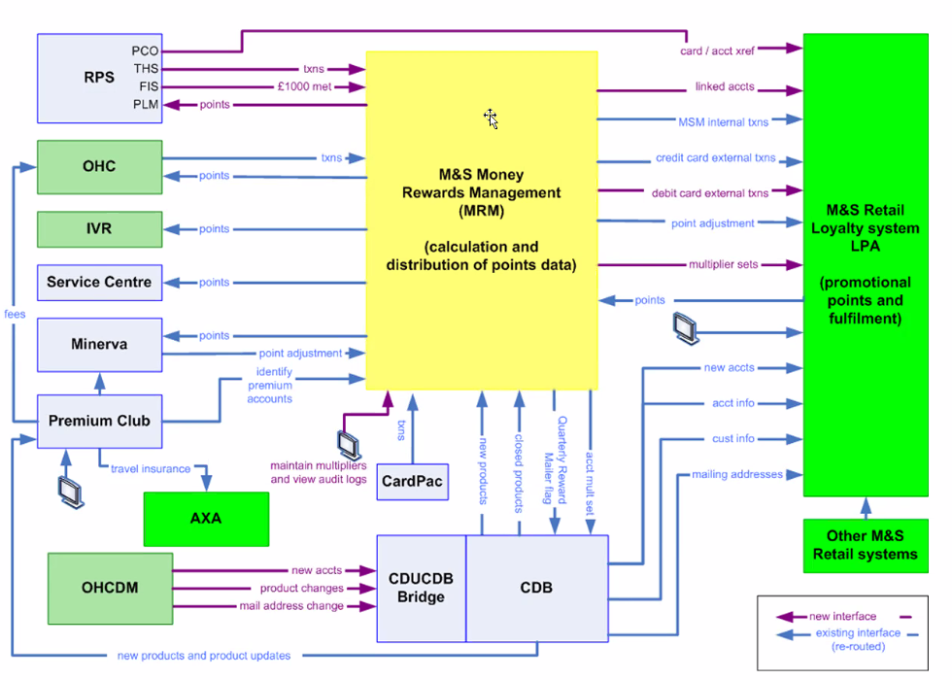
Systems

Slide 6
Contact Centre Reasons for Contact & Following Actions
Vouchers
Customer Reasons for Contact
Less than £2 – smaller spends , so don’t receive vouchers
Non-received vouchers
When’s my next set of vouchers coming through?
Expired vouchers
(less on Rewards(18 months)
Lost Vouchers
Missed “Sales” due to delays
Card opening vouchers & Current Offers and Acquisitions incentives (revolving)
Delay on Vouchers
Re-using Vouchers
Contact Centre Actions & Systems used
Provide FAQ’s
Point to website
Attach link on explanation > Swift email
Calendar for QRM , Mop ups
LPA feed into data > The Loyalty System
Confirm and relay info:
how many points into vouchers & dates
use of vouchers,
Add & remove points and cancel monetary vouchers. + Bonus points allocation.
Register complaints
- Customer calls up > raises dissatisfaction
Log on Chrys
Resolve it at 1st point> send generic letter to customer
Day 3 > escalation
Channels:
IVR
Webchat – M&S
Email
Virtual Assistant
Secure messaging - PIB
Live Chat
Mobile chat
Post
Replacement Vouchers;
Rewards ( money-off) Can re-issue monetary > next QRM or send a swift with the info on(voucher no, expiry date & value, customer can use instore or online)
Bonus Offers - cant replace > good will points adjustment
Customers may receive additional loyalty points

Slide 7
Contact Centre Reasons for Contact & Following Actions
Points
Customer Reasons for Contact
Points balance queries (can view online, on receipt from purchases, and on QRM mailing)
Checking points balance and calling to confirm bonus points not received
Taking points off Customers > Mailing going out – gap in time
Timings against points & allocations
Explanation on Points to Vouchers conversions
Card opening vouchers & Current Offers and Acquisitions incentives (revolving)
Contact Centre Actions & Systems used
Provide FAQ’s
Point to website
Attach link on explanation > Swift email
LPA feed into data > The Loyalty System
Points balance in realtime,
how many points into vouchers & dates
what customer has bought on their card that relate to loyalty – broken down by purchase & where,
Expiry dates
Add & remove points and cancel monetary vouchers. + Bonus points allocation.
OHC & Echamps : Credit card servicing, credit card spends not just M&S spends > transactions, cancel cards, activate cards, what “Offer” they are on
Register complaints
- Customer calls up > raises dissatisfaction
Log on Chrys
Resolve it at 1st point> send generic letter to customer
Day 3 > escalation
Customers may receive additional loyalty points
Channels:
IVR
Webchat – M&S
Email
Virtual Assistant
Secure messaging - PIB
Live Chat
Mobile chat
Post
Replacements:
Bonus Offers - cant replace > good will points adjustment
Pointing customers to Points balance ( Receipts, QRM mailing, online)
Calendar for QRM , Mop ups

Slide 8
Contact Centre Reasons for Contact & Following Actions
Other/Complaints
Customer Reasons for Contact
Returning items > returning points/offers
Opt Out
Code not working online – M&S team try to resolve , if not handover to Bank.
Address Issues (posting to wrong/old address) – 60 day wait time
General Queries of programme –
Where can I earn points?
Complaints
Card opening vouchers & Current Offers and Acquisitions incentives (revolving)
Instore > contact Bank
If voucher doesn’t work
Signposting
Contact Centre Actions & Systems used
Provide FAQ’s
Point to website
Attach link on explanation > Swift email
Opt out – Loyalty System:
- Opt out if going overseas (address based):
On Closure of Credit Card account
Block
Replacement Vouchers;
Rewards ( money-off) Can re-issue monetary > next QRM or send a swift with the info on(voucher no, expiry date & value, customer can use instore or online)
Bonus Offers - cant replace > good will points adjustment
DPU - Letters sent out
Register complaints
- Customer calls up > raises dissatisfaction
Log on Chrys
Resolve it at 1st point> send generic letter to customer
Day 3 > escalation
OHC & Echamps : Credit card servicing, credit card spends not just M&S spends > transactions, cancel cards, activate cards, what “Offer” they are on
Channels:
IVR
Webchat – M&S
Email
Virtual Assistant
Secure messaging - PIB
Live Chat
Mobile chat
Post

Slide 9
Systems and/or Actions taken by Contact Centre Team/Agent:
Signposting and direction : FAQs, Point to PWS, Attach link on explanation > Swift email ( loyalty codes – monetary only), Pointing customers to Points balance (Receipts, QRM mailing, online). Paper statement that provides info.
Complaints : Register complaints: Log on Chrys, Resolve it at 1st point> send generic letter to customer, Day 3 > escalation
BMM: (SFE) – Customer profile, ID&V – primary uses system
(LPA feeds data into:)
The Loyalty System: Green Screens > Points balance in realtime & dates points used, use of vouchers, what customer has bought on their card that relate to loyalty – broken down by purchase & where, expiry dates – vouchers & offers. Add & remove points and cancel monetary vouchers. + Bonus points allocation.
Cardpac: Green Screen
OHC & Echamps : Cross referencing transactions > Credit card servicing, credit card spends not just M&S spends > transactions, cancel cards, activate cards, what “Offer” they are on
Replacement Vouchers: Rewards (money-off) Can re-issue monetary > next QRM or send a swift with the info on (voucher no, expiry date & value, customer can use instore or online).
Bonus Offers - cant replace > good will points adjustment. Additional points.
Replacement :
QRM – check QRM mailing lists, dates email, QRM matrix – manual process
Channels:
IVR – M&S > IVR Bank
Webchat
Email
Virtual Assistant
Secure messaging - PIB
Live Chat
Mobile chat
Post
Digital Rewards Flag (Y/N)? – editable from Y to N only
Date signed up to digital
Sparks account no/email?

Slide 10
As-IS - CUSTOMER Servicing journey
Customer Process
Credit Card Customer
Customer requires info/help
Customer access help via one of the following channels:
IVR – M&S > IVR – Bank
Bank telephone direct
Webchat
Email
Virtual Assistant
Secure messaging - PIB
Live Chat
Mobile chat
Post
Customer Contact Agent picks up request (if applicable)
Signposts : Directs Customer to website/info/FAQ’s etc & if app. sends Swift email/follow up contact
Looks up Customer file on:
OHC & Echamps
Cardpac
The Loyalty System
BMM: (SFE)
QRM matrix (retail) / Moneybox
Completes action on request e.g – refund, replacement vouchers (money-off) etc
Provides customer with info directly e.g – personal points balance, expiry dates etc
Opt out/Exceptions – see Opt Out & Exceptions journey
Raises complaint on behalf of Customer (Chrys)
Bank & Retail Systems and Processes
MRM & Loyalty system – loyalty/rewards flag
Club Rewards – if they sign up for CR – Product listed on BMM & in Cardpac & sign up date
Bank contact centre deals with all rewards queries
Bank owns all above channels except M&S IVR – who pass the caller onto M&S Bank IVR
Various processes for the different channels
Different systems for different Customer requests
Confirmation emails generated following actions
All above actions depend on the query at hand

Slide 11
PROPOSED/WIP: To-Be Customer Servicing Journey
Customer Process
Credit Card Customer
Customer requires info/help
Customer accesses help via one of the following channels:
IVR – M&S > IVR – Bank
Bank telephone direct
Webchat
Email
Virtual Assistant
Secure messaging - PIB
Live Chat
Mobile chat
Post
Customer Contact Agent picks up request (if applicable)
Signposts : Directs Customer to website/info/FAQ’s etc & if app. sends Swift email/follow up contact*
Looks up Customer file on:
OHC & Echamps
Cardpac
The Loyalty System
BMM: (SFE)
QRM matrix (retail) / Moneybox
MyWorkspace
Completes action on request e.g – refund, replacement vouchers (money-off) etc
Provides customer with info directly e.g – personal points balance, expiry dates, Info on if Digital Rewards or not
Opt out/Exceptions – see Opt Out & Exceptions journey
Raises complaint on behalf of Customer (Chrys) **
Bank & Retail Systems and Processes
MRM & Loyalty system – loyalty/rewards flag
Club Rewards – if they sign up for CR – Product listed on BMM & in Cardpac & sign up date
MyWorkspace updated with Digital Rewards Flag includes : (TBC) – see technical servicing journey
Bank contact centre deals with all rewards queries
Bank owns all above channels except M&S IVR – who pass the caller onto M&S Bank IVR
Various processes for the different channels
Digital Rewards info and options added to all channels where applicable
Different systems for different Customer requests
Confirmation emails generated following actions
Looks up to see if Customer is Digital Rewards opted in, and can view date , customer details (TBC)
* - Digital Rewards signposting added where applicable
DPU – Letter changes?
** - Digital Rewards available on Chrys?
SWIFT – new emails on DR
Contact Agent views Customer is DR and can address request appropriately (further deep dive on customer specific requests to be and as is needed)
DR - Re-Issuing & Refunds?
Contact Centre to encourage Customer to Sign up to DR if issues with As-Is Process?

